Slide 1
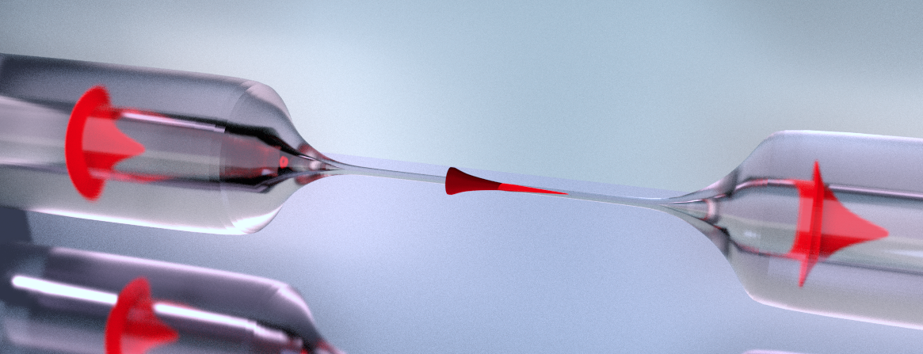
Observation of Multimode strong coupling of laser-cooled atoms to fiber-guided photons
Martin Blaha, Aisling Johnson, Alexander Ulanov
Jürgen Volz, Philipp Schneeweiss and Arno Rauschenbeutel
Notes:
Pacing ganz wichtig :d

Slide 2
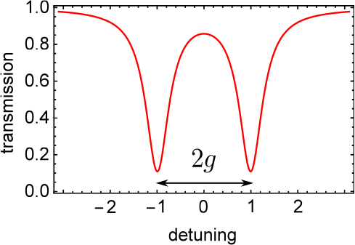
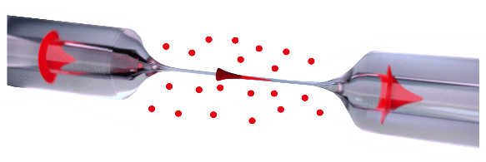
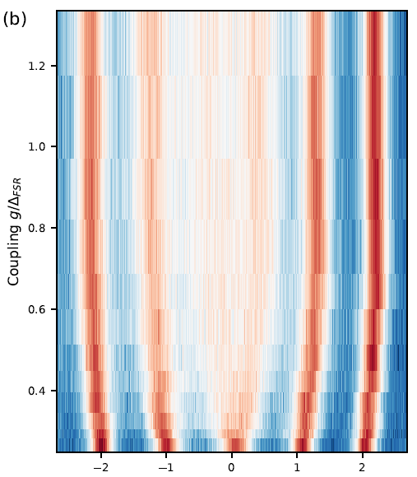
Outline
Multimode Strong coupling in CQED
opt. Nanofibers and Fiber-ring resonator
Measurements and Observations

Slide 3
Introduction
Multimode Strong coupling in CQED
opt. Nanofibers and Fiber-ring resonator
Measurements and Observations

Slide 4
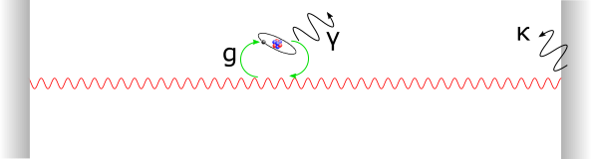
Cavity QED
Singlemode CQED
Strong coupling:
Collective coupling →

Slide 5
Multimode QED
Multimode CQED
Standard approach → tuning interaction via transverse modes
Our approach → Strong coupling to many resonator modes
g > FSR, atoms emit into different cavity modes
Strongly coupled in a single round-trip “Superstrong coupling”
D.Meiser, P. Meystre, PRA (2006)
→ Atoms and field don’t interact instantaneously, new dynamics
→ Photon modes interact via the atoms
Overcome some limits of cavity QED with one mode

Slide 6
How to observe?
Mode splitting of single mode cavity
→ Strong coupling

Slide 7
How to observe?
→ atoms interact strongly with many resonator modes
→ experimentally accessible spectrum
See Sundaresan et al., PRX 5, 021035 (2015)
Splitting and pushing of several modes
→ Multimode strong coupling

Slide 8
Multimode Strong coupling in CQED
opt. Nanofibers and Fiber-ring resonator
Measurements and Observations

Slide 9
Key Aspects
Optical Nanofiber for enhanced coupling
Long Resonator for low FSR
Length – independent coupling strenght
Notes:
ONF for evanescent field coupling
Long resonator for small FSR
Independent coupling of length, hence no loss of g but increase with atoms

Slide 10
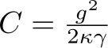
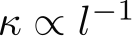
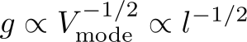
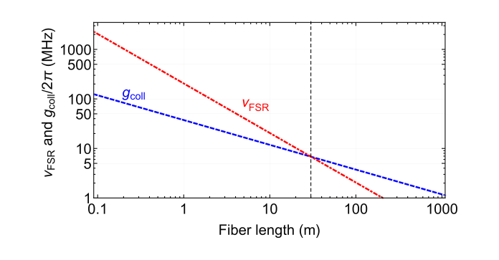
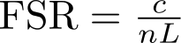
How to reach g > FSR
Length dependence of resonator parameters
Single atom cooperativity
,
→ Increase l (decrease FSR) at will (almost)
Multimode
Accessible with:
l ~ 30 m
N ~ 300 atoms
●
Schneeweiss et al., Opt. Lett. 42, 85 (2017)

Slide 11

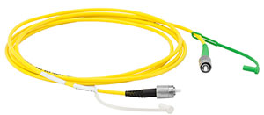
Fiber ring resonator
Optical Nanofiber
30m fiber on a spool
Adjustable beam splitter

Slide 12
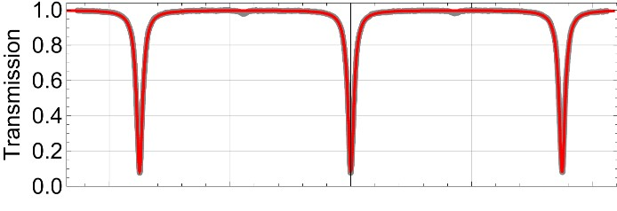
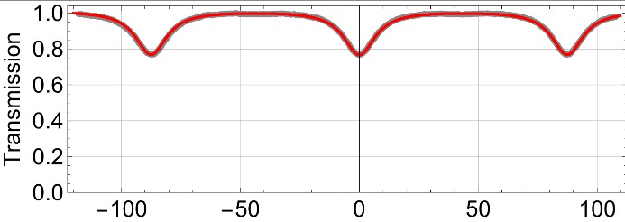
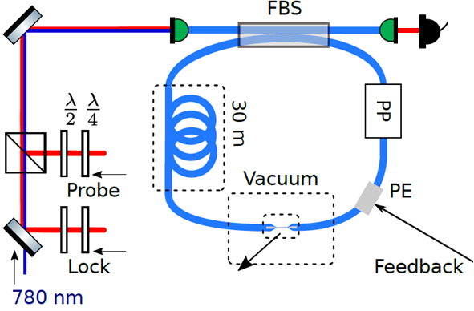
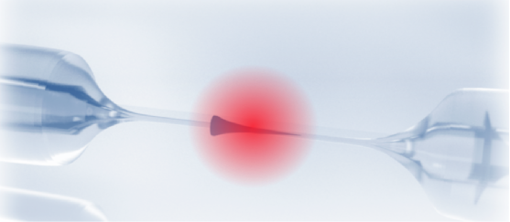
Implementation
critically coupled
over- coupled
Single photon detector
Piezo for locking
Passively insulated

Slide 13
Multimode Strong coupling in CQED
opt. Nanofibers and Fiber-ring resonator
Measurements and Observations

Slide 14
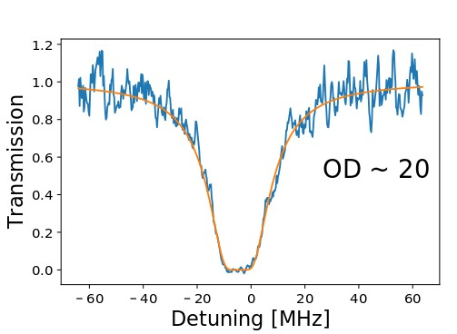
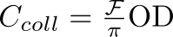
Interfacing the nanofiber with atoms
Magneto optical trap
→ reservoir of cold Cs atoms
Transmission spectroscopy → collective coupling
Set resonator to fully overcoupled → single round-trip of light
From
OD = 17.9
→ Multimode strong coupling regime

Slide 15
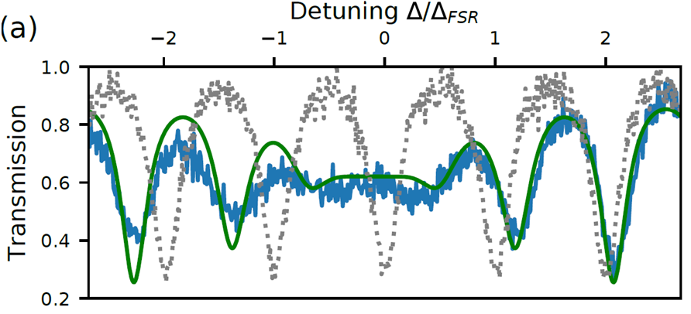
Transmission Spectrum
Set resonator to critically coupled
Transmission spectroscopy → 1ms probing pulse with frequency scanned
Resonator with atoms
Empty resonator
Theoretical prediction for g = 10 MHz

Slide 16
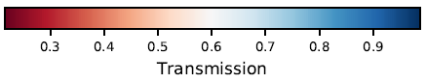
Spectrum
Vary g via the OD by tuning the MOT-nanofiber overlap
Transmission spectroscopy → 1ms probing pulse with frequency scanned
Multimode-
strong coupling regime
OD/coupling increases
Strong coupling regime

Slide 17
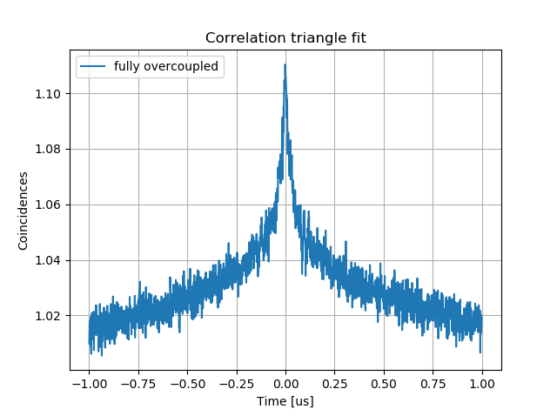
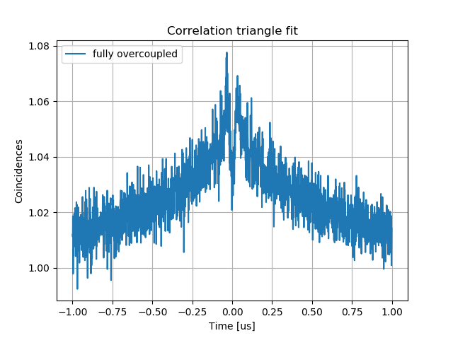
g(2) Measurements
Observe non-markovian behaviour of atom-resonator system
Investigate Nr of atoms conributing to the signal
Low OD case
Fully overcoupled regime → external excitation
Collection of fluorescence photons at the output
See K.P.Nayak et. al., Phys. Rev. A 79 (2009)
J.A.Grover et. al., Phys. Rev. A 92 (2015)

Slide 18
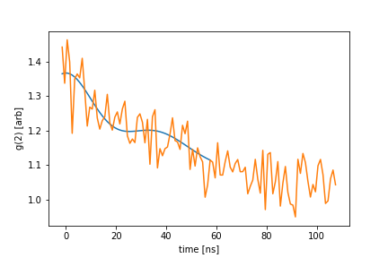
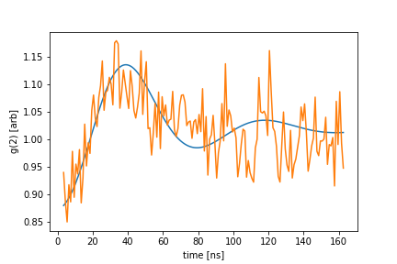
g(2) Measurements
5.8 atoms
1.44 atoms
OD per atom ~ 0.045
onset of MMSC for “effective” atom number ~ 100

Slide 19
g(2) Measurements
Strongly coupled in a only single round-trip
D.Meiser, P. Meystre, PRA (2006)
Observe non-markovian behaviour of atom-resonator system
“effective” atom number for multimode strong coupling ~ 100
Comparision between critically coupled and overcoupled resonator

Slide 20
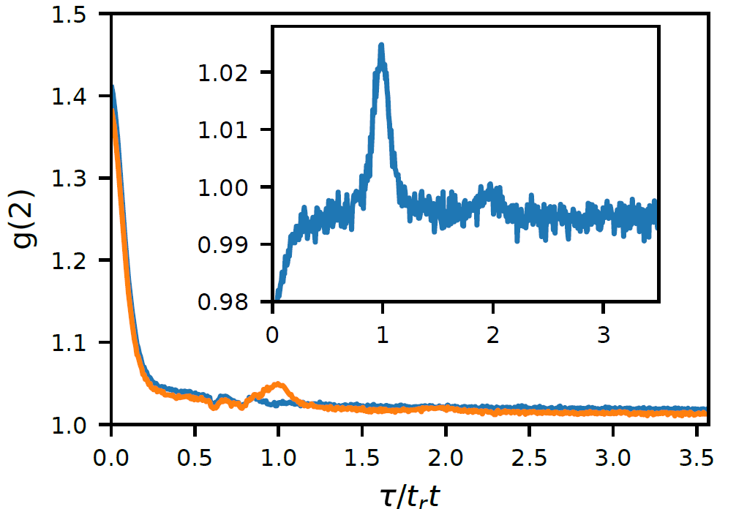
g(2) Measurements
High OD case
external excitation of around 400 atoms
Comparision between critically coupled and overcoupled resonator
Revivals at roundtrip times
→ Photons travel as a pulse and thus couple to several resonator modes

Slide 21
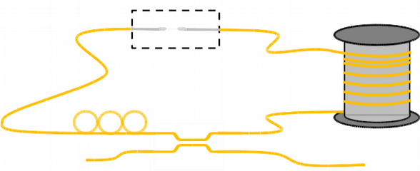
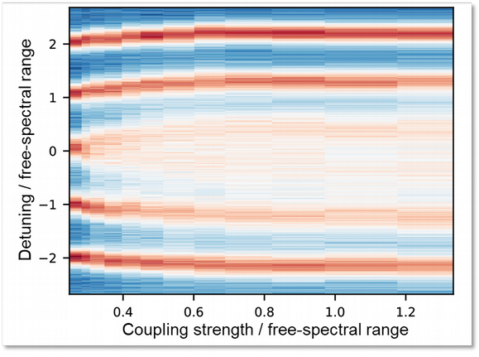
MMSC Conclusion
Nanofibre ring resonator
Combining nanofibre quantum interface and fiber ring resonator
→ entering a new regime of CQED Versatile setup
●
●
Study of multimode strong coupling
Coupling strength exceeds free-spectral range Observation of the transition:
“standard“ → multimode strong coupling
●
●

Slide 22
Outlook
Next experimental steps
Optimizing resonator finesse (reduce linewidth to 100 kHz)
Trapping atoms in evanescent field of the nanofiber
And then?
“non-Markovian”
→ new type of photon-resonator dynamics
New types of entangled states, photonic info processing...
Taylor interaction range between atoms

Slide 23
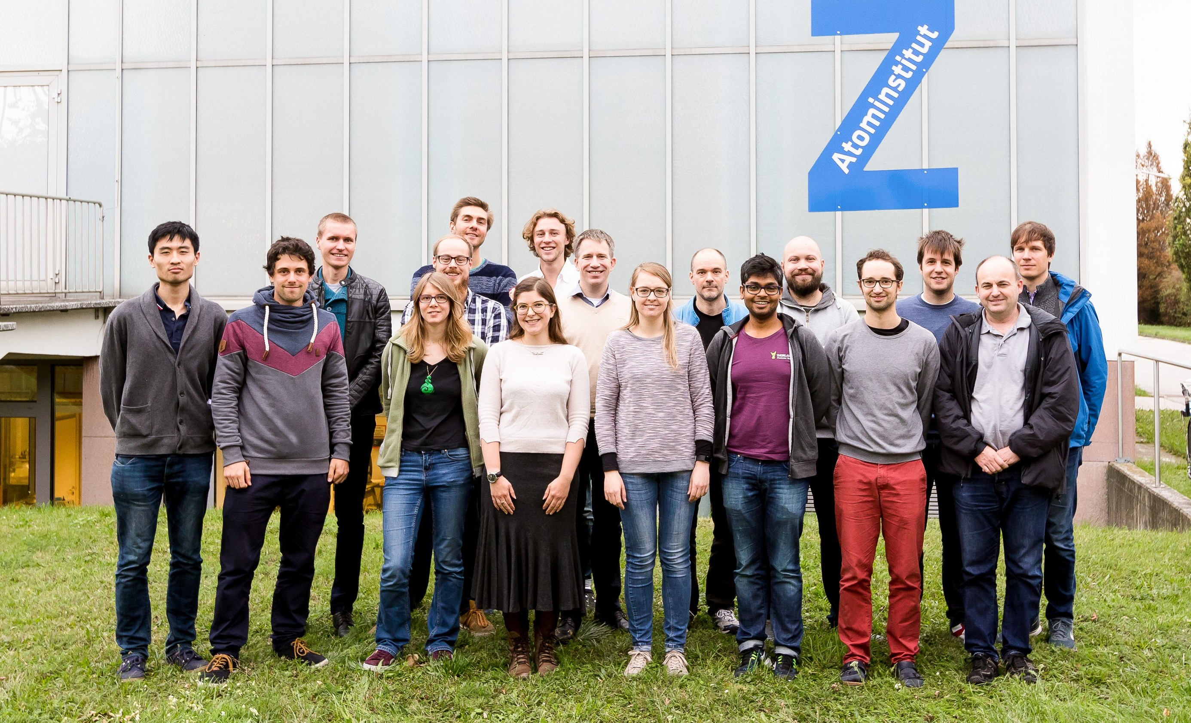




Thank you for your attention
A. Ulanov _{A. Johnson}
A. Rauschenbeutel
P. Schneeweiss
J. Volz
www.nanofiber.at

